Slide 1


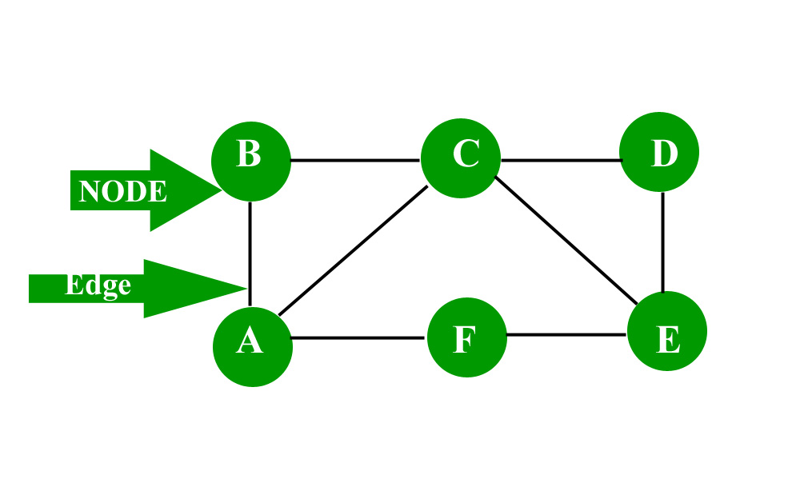
Graph Theory
A graph G = (V, E) consists of V, a non-empty set of vertices (or nodes) and E , a set of edges.
Each edge has either one or two vertices associated with it, called its endpoints.

Slide 2
Characteristics of graphs:
Adjacent node: A node ‘v’ is said to be adjacent node of node ‘u’ if and only if there exists an edge between ‘u’ and ‘v’.
Degree of a node: The degree of a vertex is the number of edges incident with it, except the self-loop which contributes twice to the degree of the vertex. Degree of a vertex u is denoted as deg(u) .

Slide 3
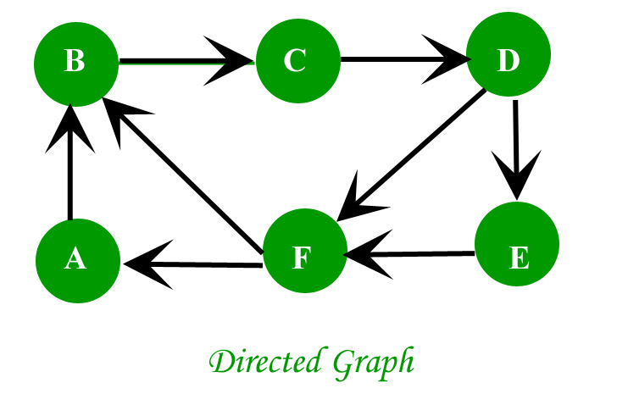
Directed graph: A graph in which the direction of the edge is defined to a particular node is a directed graph.
In directed graph , Indegree of the node is the number of arriving edges to a node. Outdegree of the node is the number of departing edges to a node.

Slide 4
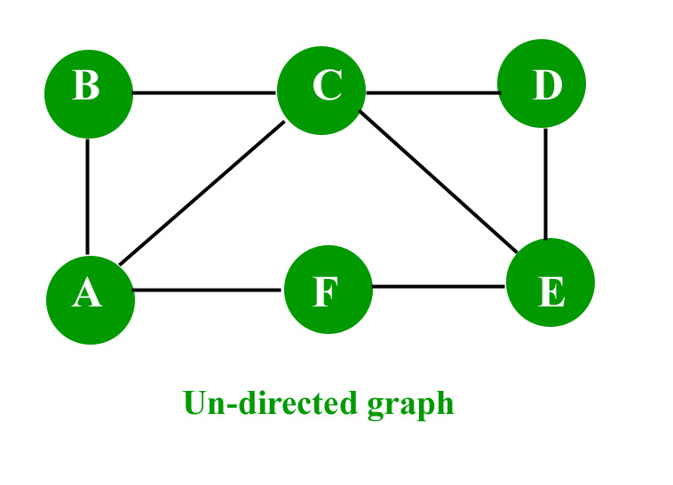
Undirected graph: A graph in which the direction of the edge is not defined. So if an edge exists between node ‘u’ and ‘v’ , then there is a path from node ‘u’ to ‘v’ and vice versa.

Slide 5
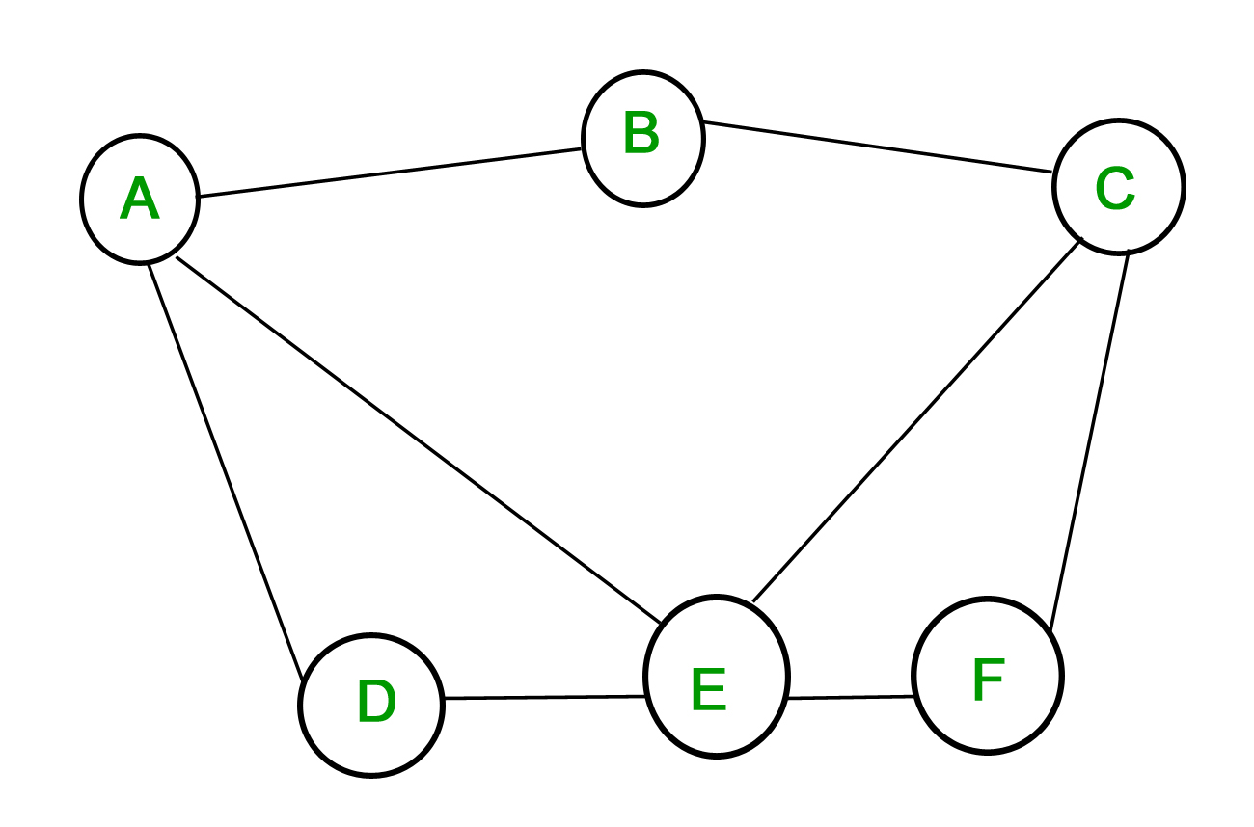
Types of graph :There are several types of graphs distinguished on the basis of edges, their direction, their weight etc.
1. Simple graph – A graph in which each edge connects two different vertices and where no two edges connect the same pair of vertices is called a simple graph. For example, Consider the following graph –

Slide 6
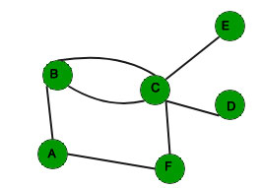
2. Multigraph – A graph in which multiple edges may connect the same pair of vertices is called a multigraph. Since there can be multiple edges between the same pair of vertices, the multiplicity of edge tells the number of edges between two vertices.

Slide 7
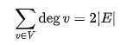
The handshaking lemma is a consequence of the degree sum formula
According to handshaking lemma the sum of the degrees (the numbers of times each vertex is touched) is twice the number of edges in the graph

Slide 8
GATE CSE 2013
Which of the following statements is/are TRUE for an undirected graph? P: Number of odd degree vertices is even Q: Sum of degrees of all vertices is even (A) P Only (B) Q Only (C) Both P and Q (D) Neither P nor Q

Slide 9
sum of odd degree + sum of even degree = 2 × no. of edges sum of odd degree = 2 × no. of edges - sum of even degree The right hand side must be even as the difference of 2 even numbers is always even. Q: each edge is counted twice so sum of degree is always even
Answer: (C)

Slide 10
GATE-IT-2004
What is the number of vertices in an undirected connected graph with 27 edges, 6 vertices of degree 2, 3 vertices of degree 4 and remaining of degree 3? (A) 10 (B) 11 (C) 18 (D) 19
sum of degree = 2 × no. of edges
$6×2+3×4+x×3=2×27$ $x=10$
Number of vertices = 6 +3 +10
Answer: (D)

Slide 11
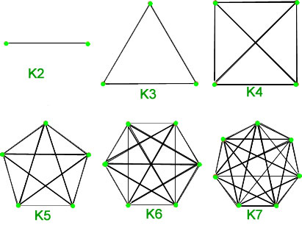
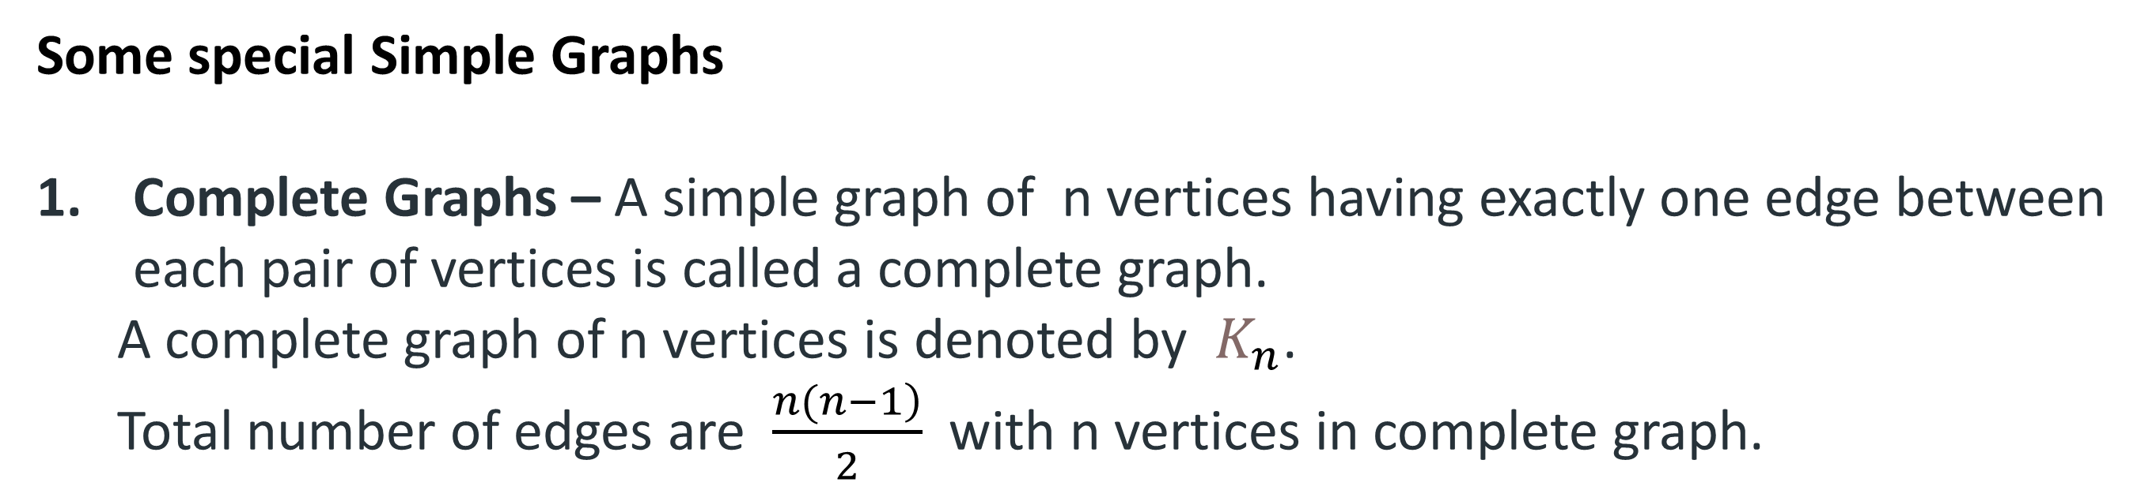
Some special Simple Graphs
Complete Graphs – A simple graph of n vertices having exactly one edge between each pair of vertices is called a complete graph.
A complete graph of n vertices is denoted by $K_{n}$.
Total number of edges are $\frac{\left.n(n−1\right)}{2}$ with n vertices in complete graph.

Slide 12
Proof for number of edges in complete graph:
Consider a complete graph with n nodes.
Each node is connected to other n-1 nodes.
Thus it becomes n * (n-1) edges.
But this counts each edge twice because this is a undirected graph so divide it by 2.
Thus it becomes $\frac{\left.n(n−1\right)}{2}$.

Slide 13
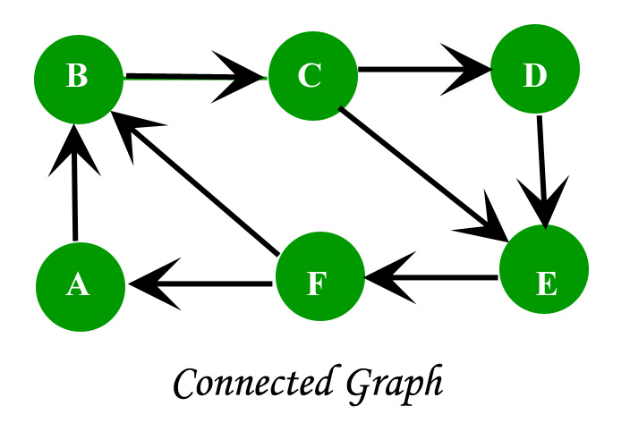
Connected graph: A graph is connected when there is a path between every pair of vertices.
In a connected graph there is no unreachable node.

Slide 14
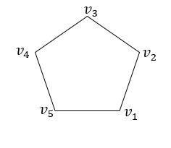
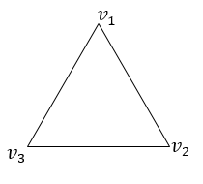
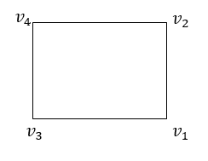
2. Cycles – Cycles are simple graphs with vertices n ≥ 3 and edges {1,2}, {2,3} ,…., and {n,1}.
Cycle with n vertices is denoted as $C_{n}$.
Total number of edges are n with n vertices in cycle graph.
$$C_{4}$$
$$C_{5}$$
$$C_{3}$$

Slide 15
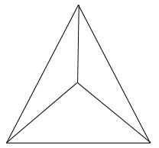
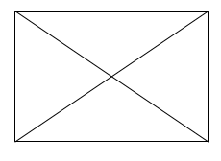
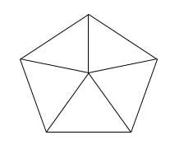
Wheels – A wheel is just like a cycle, with one additional vertex which is connected to every other vertex.
Wheels of n vertices with 1 addition vertex are denoted by $W_{n}$ .
Total number of edges are 2*(n-1) with n vertices in wheel graph.
$$W_{4}$$
$$W_{5}$$
$$W_{3}$$

Slide 16
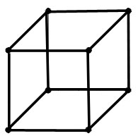
Hypercube – The Hypercube or n-cube is a graph with 2^{n} vertices each represented by a n-bit string. The vertices which differ by at most 1-bit are connected by edges.
A hypercube of 2^{n} vertices is denoted by $Q_{n}$.
Total number of edges are n* 2^{n-1} with 2^{n} vertices in cube graph.
$$Q_{1}$$
$$Q_{2}$$
$$Q_{3}$$

Slide 17
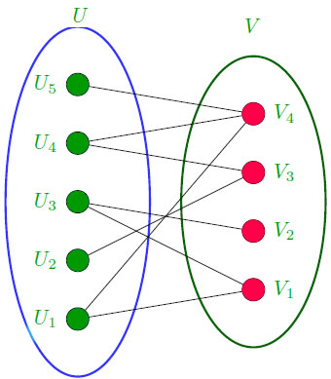
Bipartite Graphs – A simple graph G is said to be bipartite if its vertex set V can be divided into two disjoint sets such that every edge in G has its initial vertex in the first set and the terminal vertex in the second set.

Slide 18
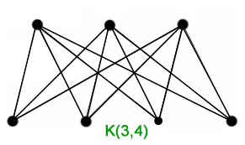
Theorem – A simple graph is bipartite if and only if it is possible to assign one of two different colors to each vertex of the graph so that no two adjacent are assigned the same color.
A graph with at least two vertices is bipartite if and only if it contains no odd cycles.
A bipartite graph with m and n vertices in its two disjoint subsets is said to be complete if there is an edge from every vertex in the first set to every vertex in the second set, for a total of mn edges.
A complete bipartite graph with m vertices in the first set and n vertices in the second set is denoted as $K_{m,n}$ .

Slide 19
GATE-CS-2014-(Set-2)
The maximum number of edges in a bipartite graph on 12 vertices is _____________. (A) 36 (B) 48 (C) 12 (D) 24
Answer: (A)

Slide 20
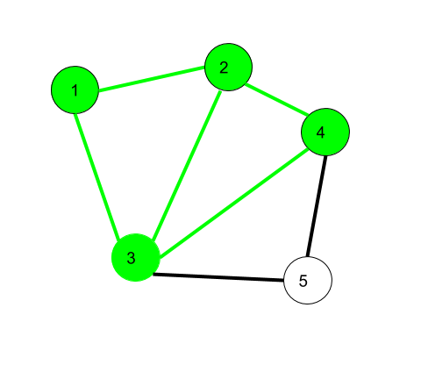
Walk – A walk is a sequence of vertices and edges of a graph i.e., if we traverse a graph then we get a walk. The number of edges in the walk is called the length of the walk.
Vertex and Edges can be repeated.
Here 1 $→$2 $→$3 $→$4 $→$2 $→$1 $→$3 is a walk.

Slide 21
Open walk-A walk is said to be an open walk if the starting and ending vertices are different i.e. the origin vertex and terminal vertex are different.
Closed walk-A walk is said to be a closed walk if the starting and ending vertices are identical i.e. if a walk starts and ends at the same vertex, then it is said to be a closed walk.
1 $→$2 $→$3 $→$4 $→$5 $→$3 is an open walk. 1 $→$2 $→$3 $→$4 $→$5 $→$3 $→1$ is a closed walk.

Slide 22
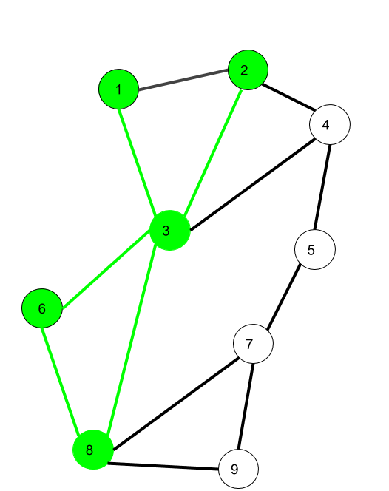
SPECIAL TYPES OF WALK
Trail – Trail is an open walk in which no edge is repeated. Vertex can be repeated.
Here 1 $→$3 $→$8 $→$6 $→$3 $→2$is trail Also 1 $→$3 $→$8 $→$6 $→$3 $→2 →$1 will be a closed trail

Slide 23
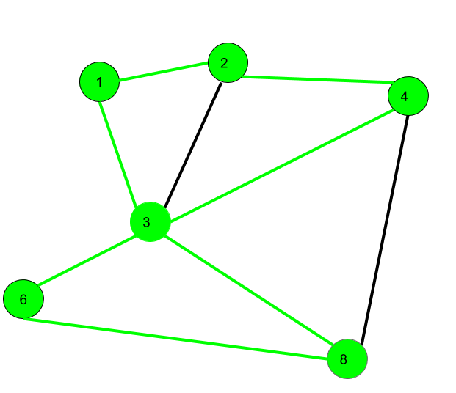
Circuit – Traversing a graph such that not an edge is repeated but vertex can be repeated and it is closed also i.e. it is a closed trail.
Vertex can be repeated. Edge not repeated.
Here 1 $→2$ $→4$ $→3$ $→6$ $→8→$3 $→$1 is a circuit

Slide 24
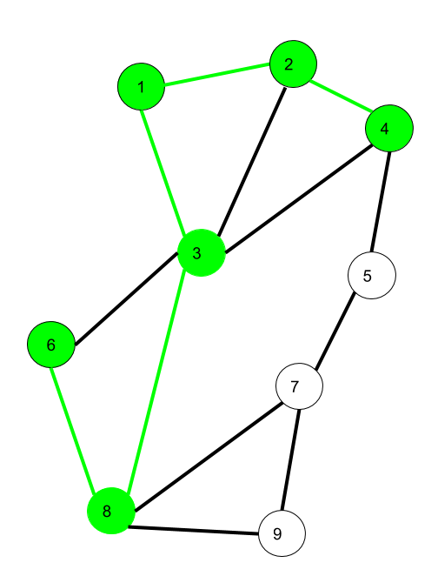
Path – It is a trail in which neither vertices nor edges are repeated i.e. if we traverse a graph such that we do not repeat a vertex and nor we repeat an edge. As path is also a trail, thus it is also an open walk.
Vertex not repeated Edge not repeated
Here 6 $→$8 $→$3 $→$1 $→$2 $→$4 is a Path

Slide 25
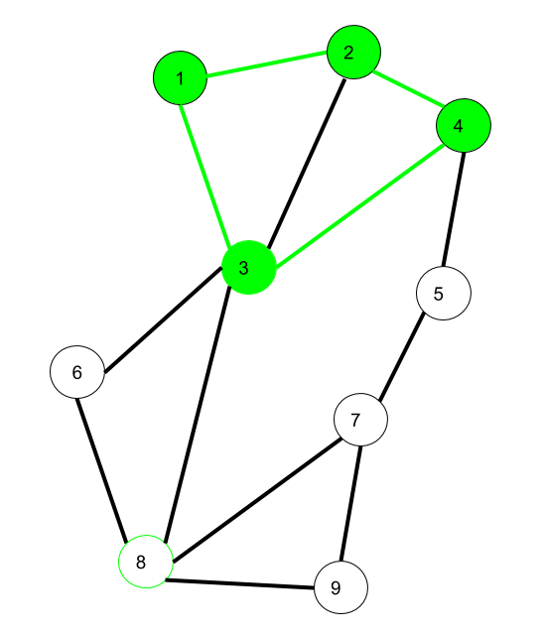
Cycle – Traversing a graph such that we do not repeat a vertex nor we repeat a edge but the starting and ending vertex must be same i.e. we can repeat starting and ending vertex only then we get a cycle.
Vertex not repeated Edge not repeated
Here 1 $→$2 $→$4 $→$3 $→$1 is a cycle.

Slide 26
Walk – A walk is a sequence of vertices and edges of a graph i.e., if we traverse a graph then we get a walk. The number of edges in the walk is called the length of the walk.
Vertex and Edges can be repeated.
Here 1 $→$2 $→$3 $→$4 $→$2 $→$1 $→$3 is a walk.

Slide 27
Open walk-A walk is said to be an open walk if the starting and ending vertices are different i.e. the origin vertex and terminal vertex are different.
Closed walk-A walk is said to be a closed walk if the starting and ending vertices are identical i.e. if a walk starts and ends at the same vertex, then it is said to be a closed walk.
1 $→$2 $→$3 $→$4 $→$5 $→$3 is an open walk. 1 $→$2 $→$3 $→$4 $→$5 $→$3 $→1$ is a closed walk.

Slide 28
SPECIAL TYPES OF WALK
Trail – Trail is an open walk in which no edge is repeated. Vertex can be repeated.
Here 1 $→$3 $→$8 $→$6 $→$3 $→2$is trail Also 1 $→$3 $→$8 $→$6 $→$3 $→2 →$1 will be a closed trail

Slide 29
Circuit – Traversing a graph such that not an edge is repeated but vertex can be repeated and it is closed also i.e. it is a closed trail.
Vertex can be repeated. Edge not repeated.
Here 1 $→2$ $→4$ $→3$ $→6$ $→8→$3 $→$1 is a circuit

Slide 30
Path – It is a trail in which neither vertices nor edges are repeated i.e. if we traverse a graph such that we do not repeat a vertex and nor we repeat an edge. As path is also a trail, thus it is also an open walk.
Vertex not repeated Edge not repeated
Here 6 $→$8 $→$3 $→$1 $→$2 $→$4 is a Path

Slide 31
Cycle – Traversing a graph such that we do not repeat a vertex nor we repeat a edge but the starting and ending vertex must be same i.e. we can repeat starting and ending vertex only then we get a cycle.
Vertex not repeated Edge not repeated
Here 1 $→$2 $→$4 $→$3 $→$1 is a cycle.

Slide 32
Isomorphism in Graph Theory
A graph can exist in different forms having the same number of vertices, edges, and also the same edge connectivity. Such graphs are called isomorphic graphs.

Slide 33
Isomorphic Graphs
“The simple graphs $G_{1}$ = ($V_{1}$, $E_{1}$) and $G_{2}$ = ($V_{2}$, $E_{2}$) are isomorphic if there is a bijective function f from $V_{1}$ to $V_{2}$ with the property that a and b are adjacent in $G_{1}$ if and only if f(a) and f(b) are adjacent in $G_{2}$.”

Slide 34
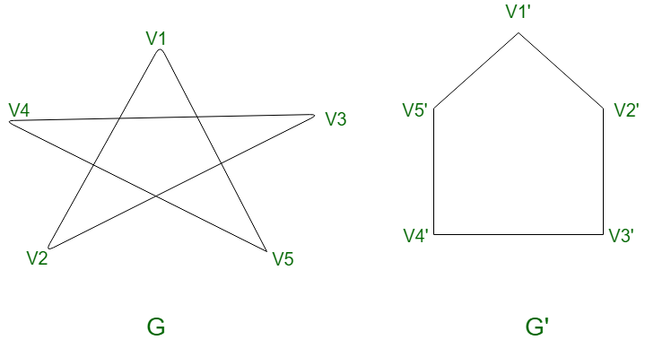
Consider the following two graphs :
$$\left.v_{1}′→f(v_{1}\right)$$
$\left.v_{2}′→f(v_{5}\right)$
$\left.v_{3}′→f(v_{4}\right)$
$$\left.v_{4}′→f(v_{3}\right)$$
$\left.{ v}_{5}′→f(v_{2}\right)$

Slide 35
You can say given graphs are isomorphic if they have:
Equal number of vertices.
Equal number of edges.
Same degree sequence
Same number of circuit of particular length

Slide 36
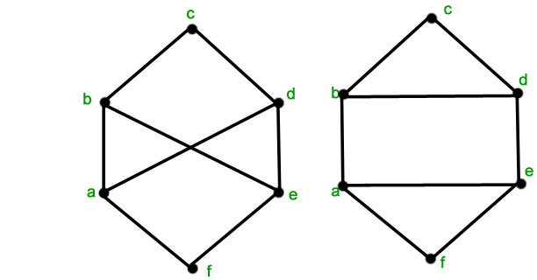
Are the two graphs shown below isomorphic?
$$G$$
$$G′$$
$G$ does not have circuit of length 4 but $G′$ has
So, $G$ and $G′$ are not isomorphic

Slide 37
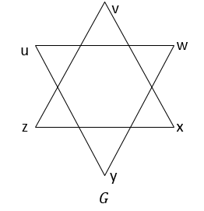
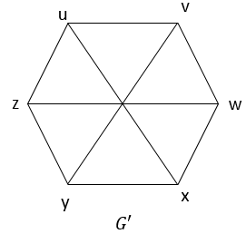
The complementary G’ of a graph G is defined as a simple graph with the same vertex set as G and where two vertices u and v are adjacent only when they are not adjacent in G.
Consequently, a graph G is said to be self-complementary if the graph and its complement are isomorphic.

Slide 38
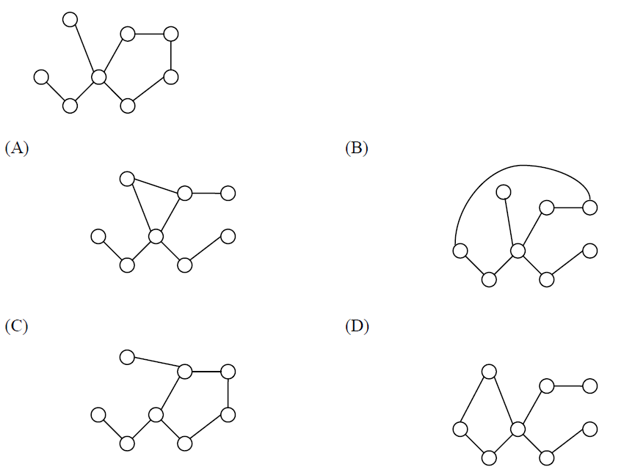
GATE CS 2012
Which of the following graphs is isomorphic to
Answer: (B)

Slide 39
GATE-CS-2015 (Set 2)
A graph is self-complementary if it is isomorphic to its complement. For all self-complementary graphs on n vertices, n is
(A) A multiple of 4 (B) Even (C) Odd (D) Congruent to 0 mod 4, or 1 mod 4 Answer: (D) Explanation: Maximum no. of edges in a graph = $\frac{\left.n(n−1\right)}{2}$
$$E\left(G\right)+E\left(G^{′}\right)= \frac{\left.n(n−1\right)}{2}$$
$$E\left(G\right)= \frac{\left.n(n−1\right)}{4}$$

Slide 40
GATE-CS-2014-(Set-2)
A cycle on n vertices is isomorphic to its complement. The value of n is _____. (A) 2 (B) 4 (C) 6 (D) 5
Answer: (D)

Slide 41
GATE-CS-2009
Which one of the following is TRUE for any simple connected undirected graph with more than 2 vertices? (A) No two vertices have the same degree. (B) At least two vertices have the same degree. (C) At least three vertices have the same degree. (D) All vertices have the same degree.
Answer: (B)
If all vertices have different degrees, then the degree sequence will be {1,2,3,....n-1}, it will not have ‘n.
Degree sequence has only (n-1) numbers, but we have ‘n’ vertices.
So, by Pigeonhole principle there are at least two vertices which has same degree.

Slide 42
Connected Graphs and Subgraphs

Slide 43
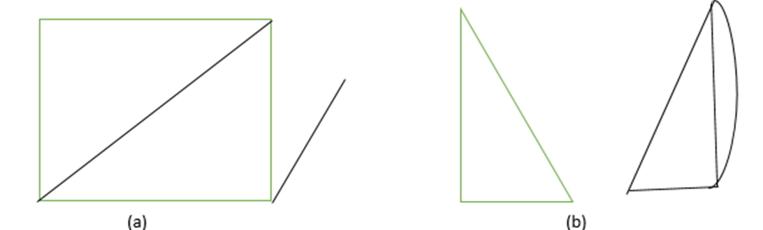
Connected Graph
An undirected graph is said to be connected if there is a path between every pair of distinct vertices of the graph.
An undirected graph is said to be disconnected if there exist at least two vertices having no path between them.

Slide 44
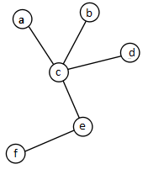
Tree
Tree is a connected graph which has no cycles.
A tree with vertices n ≥ 1 has exactly n − 1 edges.

Slide 45
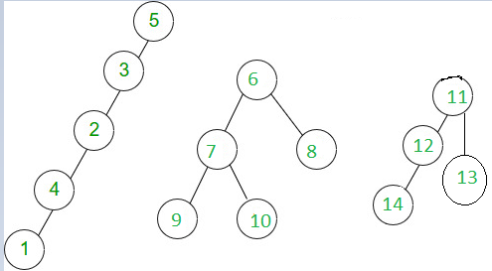
Forest
A forest is an undirected graph in which any two vertices are connected by at most one path.
Equivalently, a forest is an undirected acyclic graph, all of whose connected components are trees

Slide 46
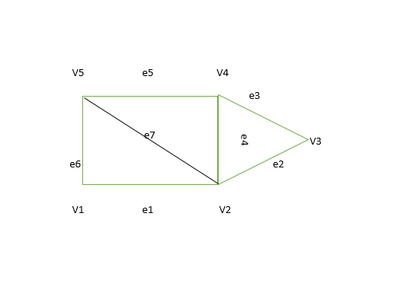
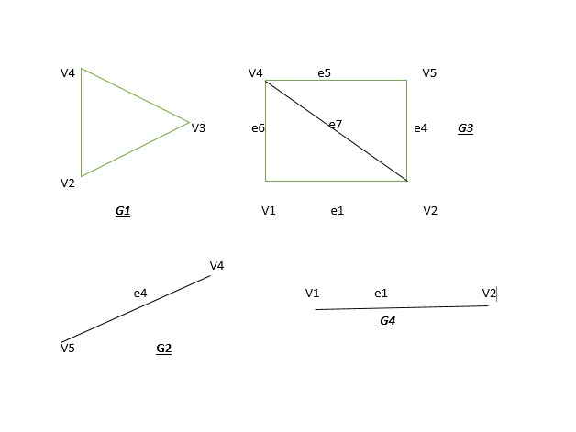
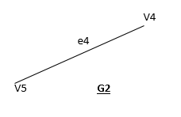
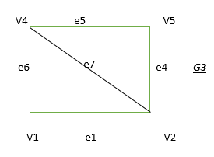
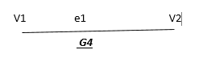
Subgraphs
A graph H = (V’, E’) is called subgraph of a graph G = (V,E) if the vertices and edges of H are contained in the vertices and edges of G.

Slide 47
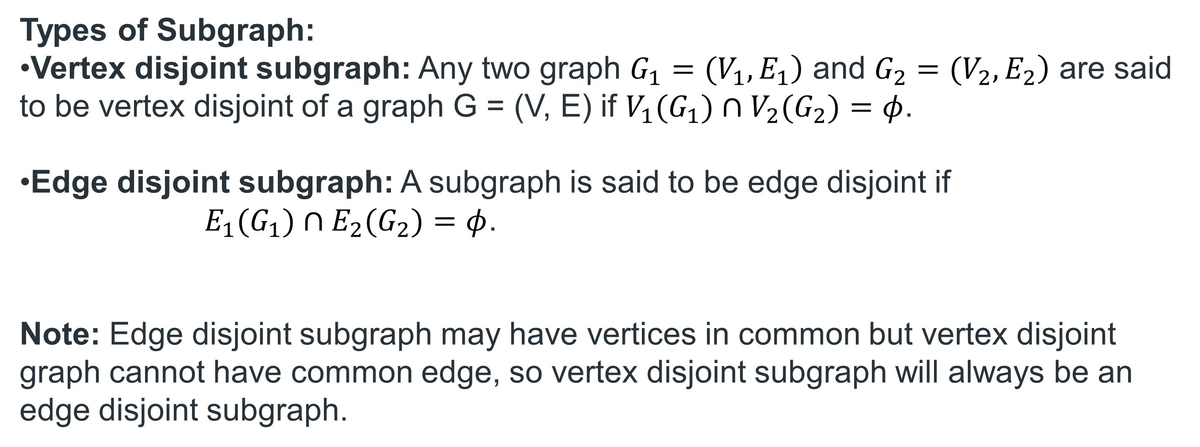
Types of Subgraph:
Vertex disjoint subgraph: Any two graph $\left.G_{1}=(V_{1},E_{1}\right)$ and $\left.G_{2}=(V_{2},E_{2}\right)$ are said to be vertex disjoint of a graph G = (V, E) if $V_{1}(G_{1})∩V_{2}(G_{2})=φ$.
Edge disjoint subgraph: A subgraph is said to be edge disjoint if
$E_{1}(G_{1})∩E_{2}(G_{2})=φ$.
Note: Edge disjoint subgraph may have vertices in common but vertex disjoint graph cannot have common edge, so vertex disjoint subgraph will always be an edge disjoint subgraph.

Slide 48
GATE-CS-2015 (Set 2)
In a connected graph, a bridge is an edge whose removal disconnects a graph. Which one of the following statements is True?
(A) A tree has no bridge
(B) A bridge cannot be part of a simple cycle (C) Every edge of a clique with size ≥ 3 is a bridge (A clique is any complete subgraph of a graph) (D) A graph with bridges cannot have a cycle
Answer: (B)

Slide 49
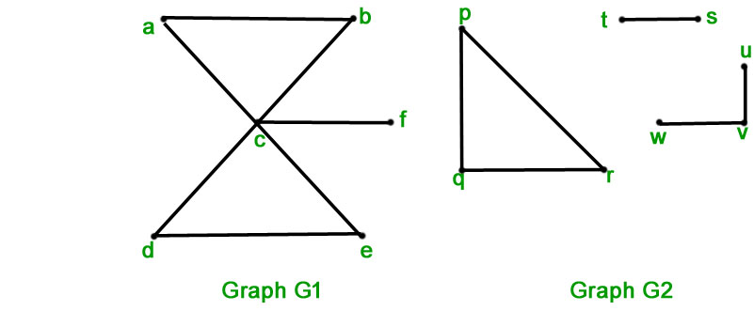
Connected Component – A connected component of a graph G is a connected subgraph of G that is not a proper subgraph of another connected subgraph of G.

Slide 50
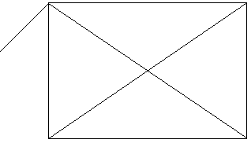
Cut set – In a connected graph G, a cut-set is a set of edges which when removed from G leaves G disconnected, provided there is no proper subset of these edges disconnects G.
$$v_{1}$$
$$e_{1}$$
$$v_{2}$$
$$e_{7}$$
$$e_{3}$$
$$v_{6}$$
$$e_{4}$$
$$v_{3}$$
$$e_{2}$$
$$e_{6}$$
$$v_{4}$$
$$v_{5}$$
$$e_{5}$$

Slide 51
Edge connectivity
The minimum number of edges whose deletion from a graph disconnects G.
The edge connectivity of a disconnected graph is 0

Slide 52
Vertex Connectivity
Let ‘G’ be a connected graph. The minimum number of vertices whose removal makes ‘G’ either disconnected or reduces ‘G’ in to a trivial graph is called its vertex connectivity.

Slide 53
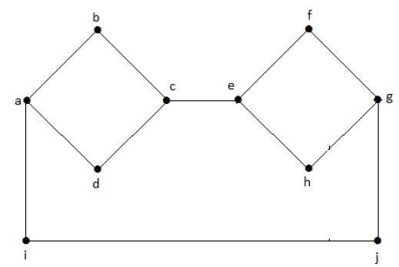
Vertex Connectivity of the given graph is 2.

Slide 54
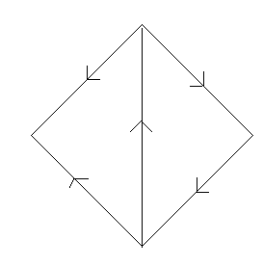
A directed graph is said to be strongly connected if there is a path from a to b and b to a where a and b are vertices in the graph.
A directed graph is called weakly connected if replacing all of its directed edges with undirected edges produces a connected (undirected) graph..
1
4
2
3

Slide 55
Strongly Connected Component – Analogous to connected components in undirected graphs, a strongly connected component is a subgraph of a directed graph that is strongly connected and not contained within another strongly connected component.

Slide 56
Euler Graphs
Certain graph problems deal with finding a path between two vertices such that each edge is traversed exactly once, or finding a path between two vertices while visiting each vertex exactly once. These paths are better known as Euler path and Hamiltonian path respectively.

Slide 57
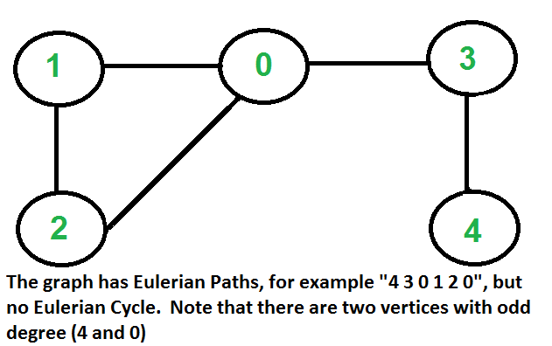
Euler paths
An Euler path is a path that uses every edge of a graph exactly once.
An Euler path starts and ends at different vertices.
Euler circuits
An Euler circuit is a circuit that uses every edge of a graph exactly once.
An Euler circuit starts and ends at the same vertex.

Slide 58
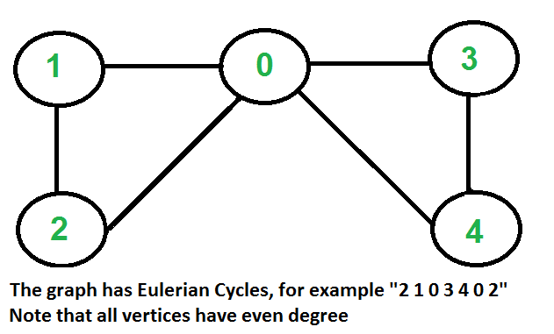
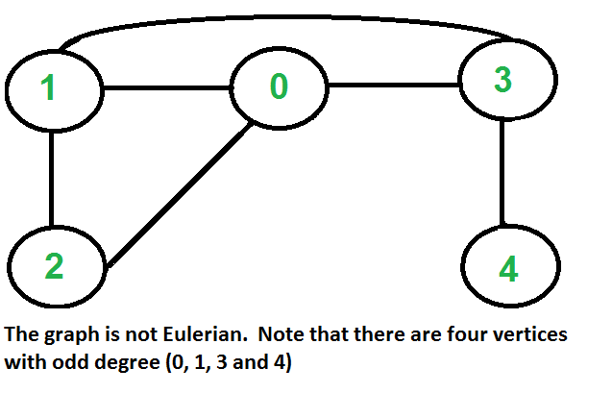

Slide 59
Theorem – “A connected multigraph (and simple graph) with at least two vertices has a Euler circuit if and only if each of its vertices has an even degree.”
Theorem – “A connected multigraph (and simple graph) has an Euler path but not an Euler circuit if and only if it has exactly two vertices of odd degree.”

Slide 60
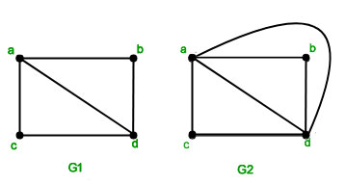
Example – Which graphs shown below have an Euler path or Euler circuit?

Slide 61
GATE-CS-2007
Which of the following graphs has an Eulerian circuit?
(A) Any k-regular graph where k is an even number. (B) A complete graph on 90 vertices (C) The complement of a cycle on 25 vertices (D) None of the above
Answer: (C)
A graph is called regular graph if degree of each vertex is equal

Slide 62
Hamiltonian Graphs
Hamiltonian Path – A simple path in a graph G that passes through every vertex exactly once is called a Hamiltonian path.
Hamiltonian Circuit – A simple circuit in a graph G that passes through every vertex exactly once is called a Hamiltonian circuit.

Slide 63
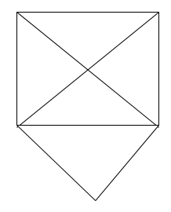
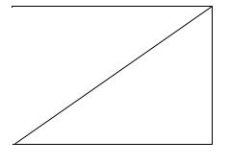
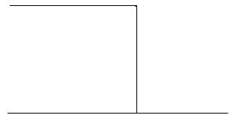
a
b
a
b
a
b
e
c
d
c
e
c
d
d
G1
G2
G3
G1 has a Hamilton circuit: a, b, c, d, e, a
G2 does not have a Hamilton circuit, but does have a Hamilton path: a, b, c, d
G3 has neither.

Slide 64
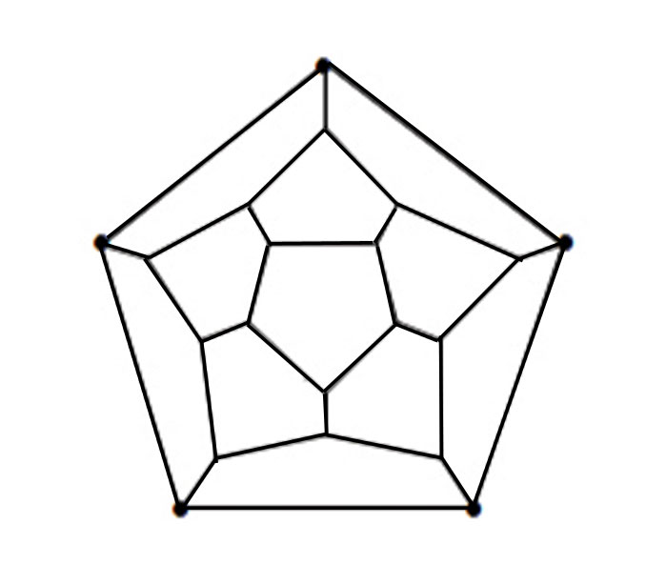
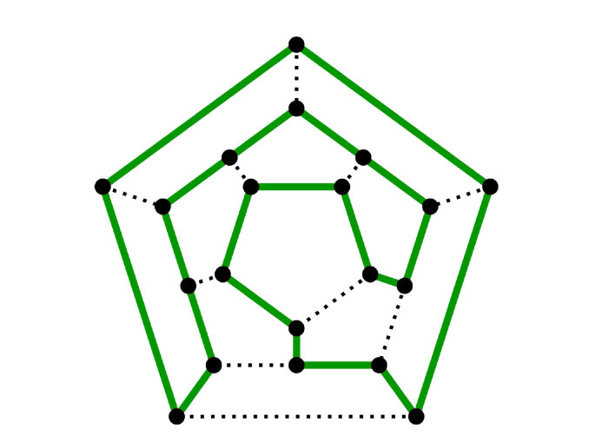
Example- Does the following graph have a Hamiltonian Circuit?

Slide 65
Theorem – If there is a vertex of degree one in a graph then it is impossible for it to have a Hamiltonian circuit.
Example - Does the following graph have a Hamiltonian Circuit?
Solution- No the above graph does not have a Hamiltonian circuit as there are two vertices with degree one in the graph.

Slide 66
Dirac’s Theorem- “If G is a simple graph with vertices $n≥3$ such that the degree of every vertex in G is at least n/2 , then G has a Hamiltonian circuit.”
Ore’s Theorem - Let G be a simple graph on n vertices. If n ≥ 3, and deg(x) + deg(y) ≥ n for each pair of non-adjacent vertices x and y, then G has a closed Hamiltonian circuit.
Note: K_{n} is Hamiltonian circuit for n ≥ 3

Slide 67
There are certain graphs which have a Hamiltonian circuit but do not follow the conditions in the previous-mentioned theorem.
For example, the cycle C₅ has a Hamiltonian circuit but does not follow the theorems.

Slide 68
Gate IT 2008
G is a simple undirected graph. Some vertices of G are of odd degree. Add a node v to G and make it adjacent to each odd degree vertex of G. The resultant graph is sure to be (A) regular (B) Complete (C) Hamiltonian (D) Euler
Answer: (D)

Slide 69
GATE CSE 2019
Let G be an undirected complete graph on n vertices, where n > 2. Then, the number of different Hamiltonian cycles in G is equal to
n!
1
(n-1)!
(n-1)!/2
Answer (D)
In an undirected complete graph on n vertices, there are n permutations are possible to visit every node. But from these permutations, there are:
n different places (i.e., nodes) you can start;
(clockwise or anticlockwise) different directions you can travel.
So any one of these n! cycles is in a set of 2n cycles which all contain the same set of edges. So there are,
= (n)! / (2n)
= (n−1)! / 2 distinct Hamilton cycles.

Slide 70

Thank you

